Slide 1
The Parable of the Mustard Seed
Discipleship – a heart for god
Jimmy mok
20 Sept 2015, b&P Ministries

Slide 2
Introduction:
What is a parable?
Why did Jesus teach in parables?
What is the meaning of the parable of the mustard seed?
How do we apply this parable as professional and in business?
What Have we Learned from this parable?
discussion

Slide 3
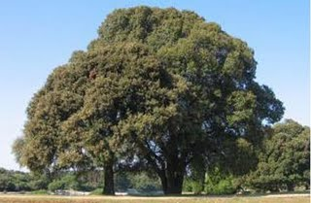
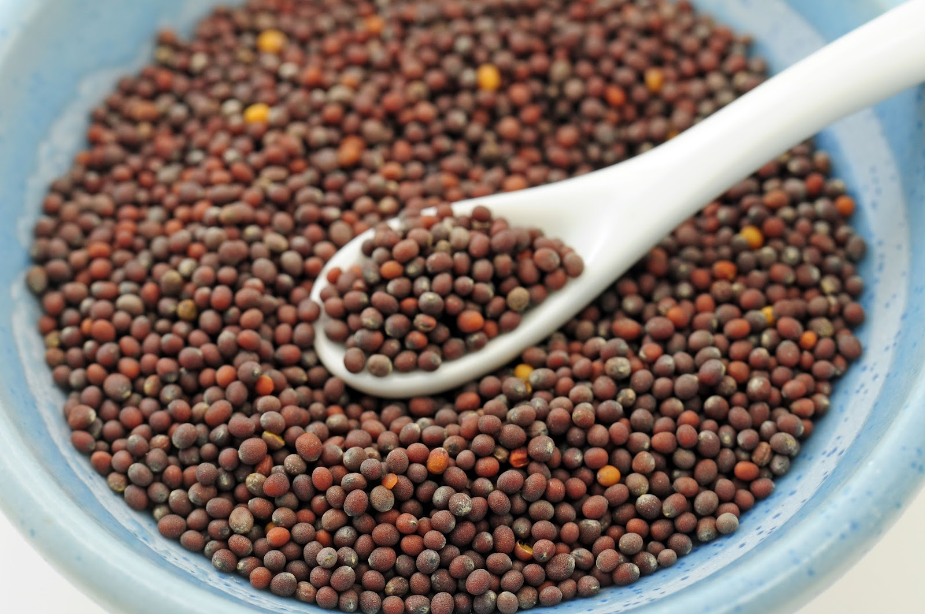

Slide 4
Discipleship – a heart for god
What is a parable?

Slide 5
A parable is, an earthly story with a heavenly meaning. It is a statement that conveys a meaning indirectly by the use of comparison or an analogy.
[Try to explain the difference between a FABLE and a PARABLE] Interpreting a parable is difficult and can present some challenges. Sometimes, interpretation is easy because the Lord Himself gave the interpretation example (1) the Parable of the Sower and the Parable of the Wheat and the Tares are both explained in Matthew 13.
And my task today is to interpret the Parable of the Mustard Seed to all of you. Mampus!

Slide 6
Discipleship – a heart for god
why did jesus teach in parables?

Slide 7
It has been said that a parable is an earthly story with a heavenly meaning. Jesus frequently used parables as a means of illustrating insightful divine truths. Stories such as these are easily remembered, the characters are bold, and the YET symbolism rich in meaning. Parables required more explanation, but once it is understood one can apply/utilise it in many ways depending on the situation. The question is why Jesus would let most people wonder about the meaning of His parables.
Let’s read Matthew 13: 10-14 [read from the bible first.]
When the disciples ask Him why, his answer may seem even more amazing: "To you it has been granted to know the mysteries of the Kingdom of Heaven, but to them it has not been granted“ [Matthew 13:11.]
The parables themselves present clear stories from everyday events that many in the crowd would recognize. All those gathered there certainly comprehended the aspects of the stories related to their everyday lives. Instead, Jesus’ teaching divided the listeners into two groups based on their own responses.

Slide 8
Jesus’ miracles had attracted many, but the parables themselves, just as in the story of the seed falling on various places “The Parables of the Sower” in Matthew 13: 3-9, revealed the true nature of people’s response and the real decisions.
Those committed to the Kingdom of God would seek and FIND further understanding. But those uncommitted—perhaps listening only because of the initial excitement—would reject the teaching as I cannot understand la.
Jesus’ ministry, when He spoke in parables, He explained the parables only to His disciples. But those who had continually rejected His message were left in their spiritual blindness to wonder as to His meaning. He made a clear distinction between those who had been given “ears to hear” and those who persisted in unbelief—ever hearing, but never actually perceiving and “always learning but never able to acknowledge the truth” [2 Timothy 3:7: …..always learning but never able to acknowledge the truth.]
The disciples had been given the gift of spiritual discernment by which things of the spirit were made clear to them. Because they accepted truth from Jesus, they were given more and more truth. The same is true today of believers who have been given the gift of the Holy Spirit who guides us into all truth as mentioned in [John 16:13.] He has opened our eyes to the light of truth and our ears to the sweet words of eternal life.

Slide 9
To be frank, truth is not sweet music to all ears sometime.
Simply put, there are those who have neither interest nor regard in the deep things of God.
[So why, then, did JESUS speak in parables?]
This is the fulfillment of what had been spoken by the prophet in Psalms 78.
Read out this verses.
Psalms 78: 1-2:
[¹ My people, hear my teaching; listen to the words of my mouth. ² I will open my mouth with a parable..]
To those with a genuine hunger for God, the parable is both an effective and memorable vehicle for the transmission of divine truths. Jesus’ parables contain great volumes of truth in very few words—and His parables, rich in imagery, are not easily forgotten.
So, then, the parable is a blessing to those with willing ears. But to those with dull hearts and ears that are slow to hear, the parable is meaningless to them.

Slide 10
Discipleship – a heart for god
what is the meaning of The parable of the mustard seed?

Slide 11
Matthew 13: 31-32
Discipleship – a heart for god
[NIV]
³¹ He told them another parable: “The kingdom of heaven is like a mustard seed, which a man took and planted in his field. ³² Though it is the smallest of all seeds, yet when it grows, it is the largest of garden plants and becomes a tree, so that the birds come and perch in its branches.”

Slide 12
Discipleship – a heart for god
Mark 4: 30-32
(³⁰ Again he said, “What shall we say the kingdom of God is like, or what parable shall we use to describe it? ³¹ It is like a mustard seed, which is the smallest of all seeds on earth. ³² Yet when planted, it grows and becomes the largest of all garden plants, with such big branches that the birds can perch in its shade.”)
Luke 13: 18-19
(¹⁸ Then Jesus asked, “What is the kingdom of God like? What shall I compare it to? ¹⁹ It is like a mustard seed, which a man took and planted in his garden. It grew and became a tree, and the birds perched in its branches.”)

Slide 13
Answer:
Like with all parables, the purpose of the Parable of the Mustard Seed is to teach a concept or “big idea” using elements, like birds, weeds, and growth, that are common and easily recognized.
The possible practical reasons that Jesus used parable to teach a concept or idea by using word pictures. By depicting the concepts, the message is maintained. Two thousand years later, we can still understand these parables from the concepts.
The Parable of the Mustard Seed is contained in all three of the gospels, Matthew, Mark and Luke. However, the Gospel of Matthew provides us with the most outlying information, as it includes one parable before and after the mustard seed parable, each teaching on the same subject. Each of the three parables: (1) the weeds among the wheat, (2) the mustard seed, and (3) the yeast have six common elements in them, providing structure which helps us to interpret the individual parables. The common elements are:
about "the kingdom of heaven," the earthly sphere of profession both good and evil;
“a man,” Christ;
“a field,” the world;
“seed,” the Word of God;
”growth” or “spreading,” church growth and
the presence of evil, symbolized by weeds, birds of the air, and yeast.

Slide 14
So, the picture painted in the Parable of the Mustard Seed by Jesus is of the humble beginnings of the church experiencing an explosive rate of growth. It grows large and becomes a source of food, rest, and shelter, for both believers and pre-believers.
Jesus had only started with 12 disciples and with faith and hope the Christianity grows to where we are today. It is not hard work only, but because it is GOD’s purpose and will for all of us to know HIM.
In other words, Jesus also predicts that, while the church will grow extremely large from just a small start, but it will face challenges.

Slide 15
Discipleship – a heart for god
The kingdom of heaven.
“A man” – Christ.
“A field” – the world.
“Seed” – the word of God.
“Growth/Spreading” – the church growth and
The presence of evil – weeds, birds of the air, and yeast.

Slide 16
Discipleship – a heart for god
How do we apply this parable as professional and in business?

Slide 17
What we have learn from this parable could possibly apply to any profit or non-profit organization which is created from a small investment and has the POTENTIAL to grows into a large corporation, but will be burdened by greed, envy, theft, pride, laziness, and etc..
If a corporation is going to succeed and bear fruit the leaders and employees must notice the warning and take action to subdue sinful behaviors by monitoring and fighting against them [Godly wisdom] so that the business is not severely crippled or destroyed.
Try to explain how as professional we should behave. Share my own example:
[Professional at work]:
As I climb up the ladder of the corporate world unto important position with authority, I will need to always remind myself to be more and more humble. Why is this so? Share on how I started from the humble beginning and now my position.
Responsibility and accountability to God and the organization;
To constantly reminded that it is God’s blessings and to always remains in his word so that I do not easily be tempted by the worldly wisdom and act
It is so easy for me to be on top of the world and forget about God. It is a choice, but for me I chose to stay stronger in my FAITH.

Slide 18
[As a person for family and community]:
From a poor family to where we are now is not easy but it begins with a small steps followed by many many more small steps. My wife and I always reminded ourselves not to forget about the poor and not to be arrogant and boastful to others of our successes, but it is the blessings from God and his favors upon us and family. We have seen many friends whom have become successful, but forgotten the beginning and become arrogant and despising the community and etc.. Bottom Line:
If God`s Kingdom through Christianity is burdened by sin and evil just think how much more human beings and businesses in this world are burdened by sin and evil.

Slide 19
Discipleship – a heart for god
What have We learned from this parable?

Slide 20
Answer:
When God’s grace touches our lives it starts out small and can be increased. We can experience more of His favor from day to day.
In 2 Peter 1:2 [Grace and peace be yours in abundance through the knowledge of God and Jesus our Lord.]
We are told that God’s grace is multiplied to us “in the knowledge of God and of Jesus our Lord”. The more you behold Jesus and His love for you, the more you will see His favor work for you.
Maybe as an example but not necessary must be this way:
So if you are a business man you will find people just wanting to do business with you because they like you and feel good about you. If you are a doctor, you will find patients favoring you and you will have more patients that you can handle.
Faith is like a spark or small seed and Jesus is the dynamite powder and as we believe in God’s goodness and love toward us, He wants you to know how willing He is to act on your behalf to bless you, and how, with Christ, He will freely give you every good thing as promised in
(Romans 8:32): He who did not spare his own Son, but gave him up for us all – how will he not also, along with him, graciously give us all things.
God wants us to always be conscious of His grace abounding toward us and all-encompassing us. It is God’s grace that supplies and multiplies the little that we have and fills us up to overflowing.

Slide 21
Philippians 4:19 [Whatever you have learned or received or heard from me, or seen in me – put it into practice. And the God of peace will be with you.]
Philippians 4:19 means “And my God shall supply all your need according to His riches in glory by Christ Jesus.” You know, no man can truly enjoy living in this world without God’s strength in his life, God’s favor in his work and relationships, God’s protection for him and his family, God’s increase in his finances, and God’s health for his body. That is why we need to stay in God’s Word and feed on Jesus and His love for us. So that then, we will be filled with the fullness of God.
[WE NEED to put it into practice what we have learned]

Slide 22
Let me summarize the lessons Jesus teaches from this parable:
1. SIZE DOESN’T MATTER TO GOD You will never be too small for God and, as a matter of fact, you’re just the right size for God to use you right now. God is more concerned with what you’re becoming, not with what size you are right now. 2. GOD WANTS YOU TO GROW
God always wants to make the small larger just like a seed as it grows into a plant.
3. GROWTH MUST BE ACCOMPANIED WITH WISDOM
You have to know who is in your tree and make sure that they don’t have a evil’s tools in their hand. God is the one who causes the seed to grow. The farmer can’t make it grow. God causes the smallest, most insignificant seed to grow into something that is the biggest and greatest tree. There is no limit with God. In God’s kingdom a plant doesn’t stay a plant it becomes a tree.
1 Corinthians 3:6,7 says, “I planted the seed, Apollos watered it, but God made it grow. So neither he who plants nor he who waters is anything, but only God, who makes things grow.”

Slide 23
discussion:
1. Which of the smallest seed in your life that you want to pay attention?
2. And how you would nurture it to grow?

