Slide 1
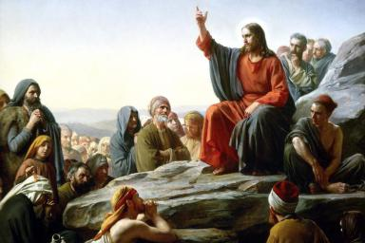
Let Go to gain Victory. Blessed are the poor in spirit, for theirs is the Kingdom of God. Matthew 5:3
Sermon on the mount

Slide 2
Let Go to gain Victory.
Matthew 5:3
Blessed are the poor in spirit,
for theirs is the Kingdom of heaven
Matthew 5:3

Slide 3
Let Go to gain Victory.
What does it mean to be poor in spirit?

Slide 4
Let Go to gain Victory.
Who are the poor in spirit?
What is the Kingdom of heaven?
Notes:
Two questions and they are related to one another.

Slide 5
Let Go to gain Victory.
Queen Sheba – 1 King 10:5 –grandeur of Solomon building …..
there was no more spirit in her
Job: Man of integrity – Job 42:5-6, meets God
King David – Psalm 51: 17, asked for forgiveness

Slide 6
Let Go to gain Victory.
5. Isaiah 6:5
"Woe is me! For I am lost; for I am a man of unclean lips, and I dwell in the midst of a people of unclean lips; for my eyes have seen the King, the Lord of hosts!" (Isaiah 6:5).
6. The Canaanite Woman
7. Peter – Luke 5:8

Slide 7
Let Go to gain Victory.
8. The Centurion
9. The Rich man- he cannot let go of his money. What did Jesus said? It is more difficult for a …. Luke 18:18-25
Paul
"I know that nothing good dwells within me, that is, in my flesh” (Roman 7:18).

Slide 8
Let Go to gain Victory.
What Then Is Poor in Spirit?
It is a sense of powerlessness in our self.
It is a sense of spiritual bankruptcy and helplessness before God.
It is a sense of moral uncleanness before God.
It is a sense of personal unworthiness before God.
It is surrendering to God. It is to let go...

Slide 9
Let Go to gain Victory.
What about your story?
Still living in your past glory?
Pride still preventing you?

Slide 10
Let Go to gain Victory.
THT Story of conversion

Slide 11
Let Go to gain Victory.
To be poor in spirit is to know that we have nothing to offer to God. We surrender, we let go for him to catch hold.
There is nothing that we can do but to seek His help and to say “ Lord, I need you, please come into my life.”
Most of us who came to this surrendering, almost always utter the same statement that I did above.

Slide 12
Let Go to gain Victory.
What is the Kingdom of heaven?
Notes:
Eternal Life

Slide 13
Let Go to gain Victory.
Most assuredly, I say to you, unless
one is born again, he cannot see the
Kingdom of God. John 3:3
Notes:
Born again – saved.

Slide 14
Let Go to gain Victory.
When you let go, then only can
God catch hold!
Victory is yours with God

Slide 15
Let Go to gain Victory.
If anyone is in
CHRIST
-He is a New-
CREATION
2 Corinthians 5:17

Slide 16
Let Go to gain Victory.
Q1.What have you not surrendered?
Q2. Why do you need to let go?
Q3. If you don’t, how will this impact
you personally, family, work?

