Slide 1
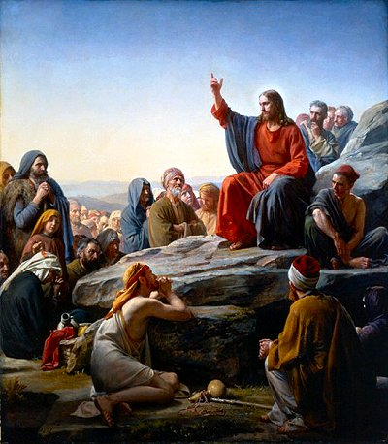
Strength in Meekness

Slide 2
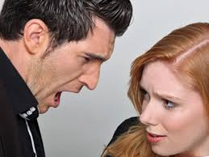
Strength in Meekness

Slide 3
Strength in Meekness
Matthew 5:5
"Blessed are the meek, for they will inherit the earth”
“Blessed” -- Gk : Happy, god-like joy
“Meekness” – Gk Praotes

Slide 4
Strength in Meekness
Meekness is Power Under Control
“Blessed is the man who has every instinct, every impulse, every passion under control. Blessed is the man who is entirely God-controlled.”
Meekness is the refusal to exercise power aggressively to safeguard our right
Meekness is persuasive. Proverbs 25:15 b (NCV) “A gentle word can get through to the hard-headed.”
If we have the right opinion of our self before God, it will spill over into our relationship with our fellow human being, at home and at work.

Slide 5
Strength in Meekness
Meekness is Power Under Control
Meekness is self-control that keeps quiet when criticized
Looking for the kernel of truth in every criticism
James 1:19–21:
“Know this, my beloved brethren. Let every man be quick to hear, slow to speak, slow to anger, for the anger of man does not produce the righteousness of God. Therefore put away all filthiness and rampant wickedness and receive with meekness the implanted word, which is able to save your souls.”(ESV)
Gentleness disarms critics
II Tim 2:25 “And the Lord’s servant must never quarrel; instead, he must be kind and gentle with everyone. They must be able to teach effectively and be patient with difficult people….Those who oppose him, he must gently instruct, in the hope that God will grant them repentance leading them to know the truth.”

Slide 6
Strength in Meekness
Meekness is Power Under Control
Gentleness diffuses conflicts
Prov 15:1 “A gentle answer turns away wrath, but a harsh word stirs up
anger.”
Eccles 10:4 (NLT) “If your boss is angry with you, don’t quit! A quiet, gentle spirit can overcome even great mistakes”

Slide 7
Strength in Meekness
Meekness Is a Controlled Expression of Anger
“Blessed is the man who is always able to be angry at the right person for the right reason for the right amount of time.”
Galatians 6:1-2. “Brethren, if a man is overtaken in any trespass, you who are spiritual should restore him in the spirit of meekness. Look to yourself, lest you be tempted.”

Slide 8
Strength in Meekness
3. Meekness is Humility
“Blessed is the man who has the humility to know his own ignorance, his own weakness, and his own need.”
James 1:19–21:
“Know this, my beloved brethren. Let every man be quick to hear, slow to speak, slow to anger, for the anger of man does not produce the righteousness of God. Therefore put away all filthiness and rampant wickedness and receive with meekness the implanted word, which is able to save your souls.”(ESV)
Meekness is teachable
Meekness is reasonable

Slide 9
Strength in Meekness
For They will Inherit the Earth
Prov 16:32. "He that rules his spirit is better than he who takes a city“
Col 1:12. “And giving joyful thanks to the Father, who has qualified you to share in the inheritance of his holy people in the kingdom of light”

Slide 10
Strength in Meekness
How to be meek
Meekness makes us like Jesus
“Come unto me, all ye that labour and are heavy laden, and I will give you rest. Take my yoke upon you, and learn of me; for I am meek and lowly in heart: and ye shall find rest unto your souls.” (Matt 11:28-29)
The Choice is Yours!

Slide 11
DISCUSSION QUESTIONS
Meekness is: Controlled expression of anger
Is your anger with the right people, flowing out of a zeal for God’s honor, and is it for the right amount of time?
In what situations and with whom, do you need to move beyond righteous anger to plead God’s grace for them?
Meekness is: Power under control:
With whom and in what situations do you need to be less assertive, aggressive and demanding, and instead hold your rights loosely, trusting in God to protect your rights as he sees fit?
Meekness is: Self-control when criticized
What is your most common response to criticism? How might that change if you really believed that God would defend you?
What is the kernel of truth in any recent criticism that you may have received?
Are you able to be free from the desire for defense and retaliation?

